Slide 1
Operating Systems
Notes:
During the Linux Essentials sessions we will follow the basic Linux topics. We will concentrate on theory in the first session then practice during the following sessions.

Slide 2
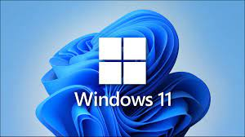
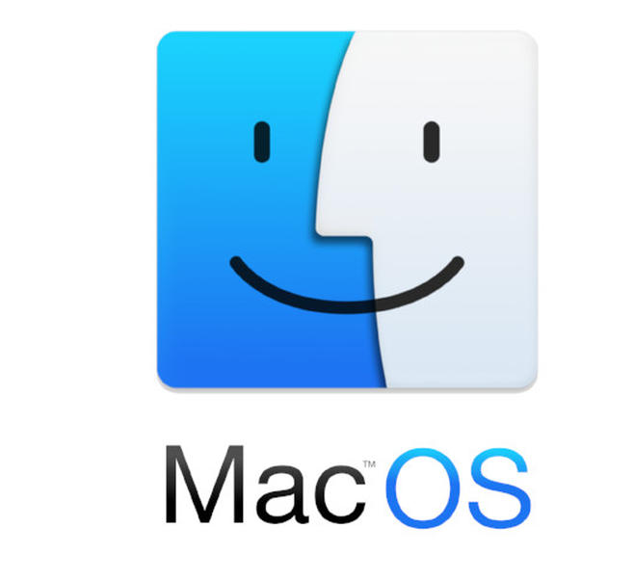



Operating Systems
Notes:
Basic Input/Output System
Software that initializes hardware and remembers system time.

Slide 3
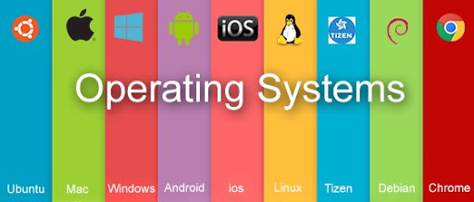
Operating Systems
OPERATING SYSTEMS:
AN OPERATING SYSTEM (OS) IS SYSTEM SOFTWARE THAT MANAGES COMPUTER HARDWARE AND SOFTWARE RESOURCES AND PROVIDES COMMON SERVICES FOR COMPUTER PROGRAMS REQUIRE AN OPERATING SYSTEM TO FUNCTION.
Notes:
Software that manages computer hardware and software.
We’re going to load OS from HDD.
Job of the OS is to let you use other computer programs.
Linux, Unix, Windows, Apple.
Even different brands, two different approaches when you power up.
Both fundamentally same. Both just allow you to interact with your computer do some stuff.
Detecting an input from the keyboard,
Sending output to the monitor or tracking files or folders in the storage area,
Controlling peripheral devices such as disk drives and printers,
Running different programs at the same time and not letting interfere with each other,
Checking users if they are authorized or not are some examples of controlling and monitoring system activities.

Slide 4
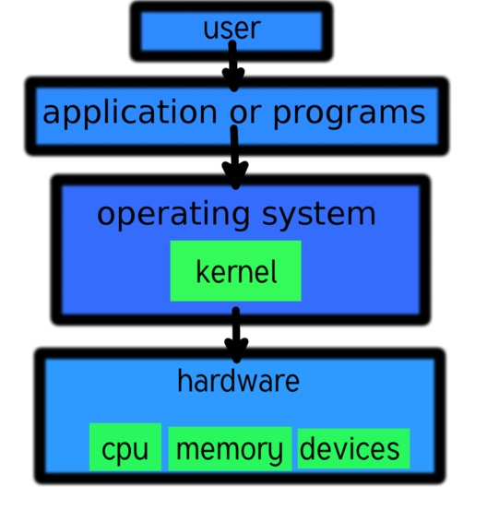
Operating Systems
Notes:
Basic Input/Output System
Software that initializes hardware and remembers system time.

Slide 5

Introduction to Linux
Linux Essentials
Notes:
During the Linux Essentials sessions we will follow the basic Linux topics. We will concentrate on theory in the first session then practice during the following sessions.

Slide 6
Table of Contents
Why/Where/When Linux
Linux Evolution
Major Open Source Applications
FSF and OSI
Open Source Software and Licensing
Using Linux on Different Platforms
Notes:
Here are the topics we will cover today. I will shortly answer the questions: Why, where and when Linux.
Then, I will explain the evolution of Linux. And address open source applications. Afterwards I will mention open source software and licensing and talk about Free Software Foundation and Open Software Initiative. Lastly, I will explain how can we use Linux on different platforms.

Slide 7
Why Linux?
Where Linux?
When Linux?
Notes:
I will answer my question in three parts. Why, Where and When.

Slide 8
Why Linux?
Total cost of ownership
Beginner friendly and easy to use
Reliability
Hardware
Software
Security
Freedom
Annoying crashes and reboots
Server segment
Linux is everywhere
* http://www.linuxandubuntu.com
Notes:
First, why Linux? You can find hundreds of reasons for migrating from Windows to Linux. Here are just a few of them. I will not dive details, instead just give the headlines.
http://www.linuxandubuntu.com/home/10-reasons-why-linux-is-better-than-windows#:~:text=Linux%20can%20be%20installed%20and,as%20per%20the%20user%20requirements.

Slide 9
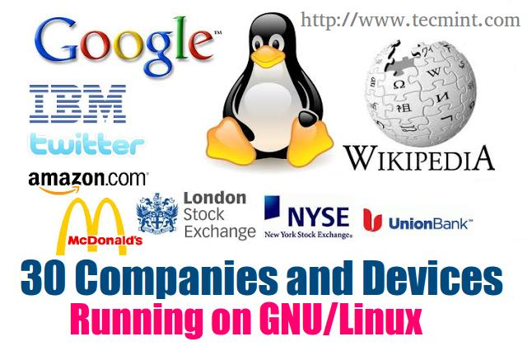
Where Linux?
Notes:
Yes, you see the the most famous and known companies in the world, right?

Slide 10
Where Linux?
1. Google
The services of which includes search, cloud computing and online advertising technologies runs on Linux.
2. Twitter
Twitter, famous online social networking and micro-blogging site is Powered by Linux.
3. Facebook
Facebook, one of the most famous and most widely used Social Networking service runs on the same platform.
4. Amazon
An American based international company which deals with International Online Retailing is in the list of Linux powered Company.
5. IBM
IBM (International Business Machine Corporation) the American based company which for sure don’t requires any introduction, is again powered by Linux.
Cited from: https://www.tecmint.com
Notes:
Second, where Linux?
Because of the length of the lists, I could not show them on one slide. Here are just a few examples.
https://www.tecmint.com/big-companies-and-devices-running-on-gnulinux/#:~:text=Schools%2C%20colleges%20and%20Universities%20in,the%20most%20sought%20after%20platform.
https://en.wikipedia.org/wiki/List_of_Linux_adopters
https://www.comparebusinessproducts.com/fyi/50-places-linux-running-you-might-not-expect

Slide 11
Where Linux?
6. McDonalds
The world’s largest chain of hamburger fast food restaurant uses GNU/Linux (Ubuntu) too.
7. Submarines
The submarines in the United State Navy are controlled by same platform.
8. NASA
National Aeronautical and Space Administration, The United Nations Space program widely uses Linux in many of their programmes.
9. Watches
Most of you would not be knowing that there are Linux Powered Watches in the market, already. The watch developed by IBM running Linux.
10. Mobile Devices
True, you all know that Linux is powering Mobile Phones, Tablets and Kindle.
Cited from: https://www.tecmint.com

Slide 12
Where Linux?
11. Space
A Specific Linux Distro (Debian) is already in the space. Debian led all the rest.
12. Raspberry pi
The business card sized computer designed for electronic projects as well as desktop computing which is very cheap in cost and is fully functional. Raspberry is a landmark in Linux Development.
13. Desktop Computing
Though a little late, Linux made a notable presence in the desktop computing market. In school and academics as well as in government offices Linux are being widely used, these days.
14. Corporates
The corporate offices are using Linux and finds it more productive than any other alternatives.
Cited from: https://www.tecmint.com

Slide 13
Where Linux?
15. New York Stock Exchange
New York Stock Exchange (NYSC) which provides means for buyers and sellers in order to trade shares of stock in companies registered for public trading relies solely on Linux.
16. Traffic Controlling
The Traffic controlling system in most of the countries be it Road Traffic or Air Traffic Linux proved to be the best than any other available alternative.
17. Nuclear Projects
When it comes to Nuclear Ambitious projects, Linux is the best option. One of such OS is QNX, which lately is acquired by Blackberry Ltd.
18. Bullet Trains
The Bullet Trains in Japan runs at the speed of 240-320 km/h. All train tracking, maintenance, scheduling and controlling is Linux based.
Cited from: https://www.tecmint.com

Slide 14
Where Linux?
19. Internet Hosting
More than 70% of Internet Hosting and service providers are Linux based. Thought this statistic is difficult to figure out but based upon the Linux compatible hardware sold, and demand for cross platform compatible hardware, the above statistics is a rough estimation.
20. Missiles and Weapons
The Missiles and destructive weapons of next generation is themed to be much advanced and Intelligent system than its predecessors. Well what else would have been its alternative.
Cited from: https://www.tecmint.com

Slide 15

When Linux?
Notes:
Third and the last question is: when Linux?
The answer is easy and straightforward: You can use Linux anywhere at anytime, or everywhere at every time.
Examples? Definitely.
You will use Linux during your following cohorts, particularly in AWS DevOps Path.
And during interviews you may encounter questions about Linux as well.

Slide 16
Linux Evolution

Slide 17
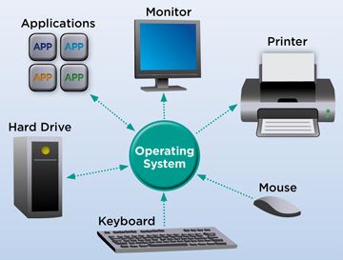
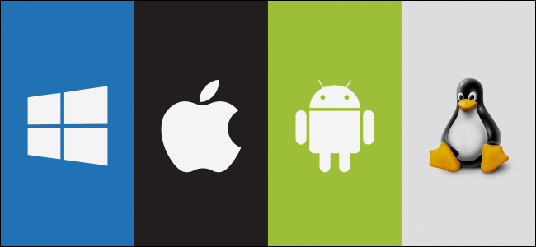



What is Linux?
Free
Open-Source
OS
Notes:
Linux is a Free and Open-Source Operating System just like Windows, iOS or MacOs.
This sentence alone, comprises three completely different dimensions. First one is free, second one is Open Source and last one is Operating System.
We will explain the first two arguments: free and open source in the following slides. The last one is Operating System.
As I’ve stated earlier, Linux is an OS like any other operating systems. I will not mention OSs in detail neither.
As you have seen during CF lessons An operating system (OS) is a system software that manages computer hardware, software resources, and provides common services for computer programs.
So again, Linux is a Free and Open-Source Operating System just like many others.

Slide 18
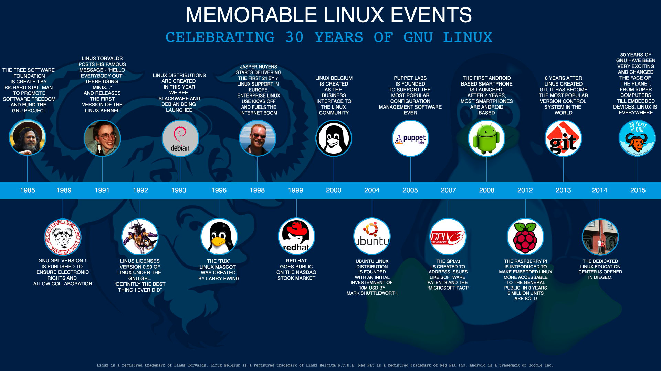
Notes:
Now, let’s have a short tour on Linux history. I will not address every point on the screen. Yet, just a few words.

Slide 19
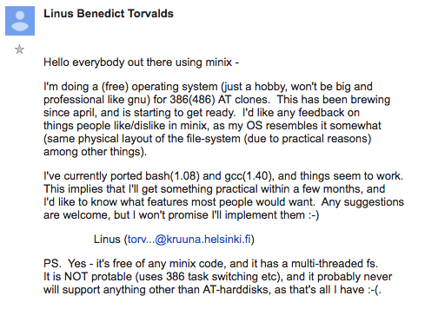
1991
Memorable Linux Events
Notes:
1991: Linus Torvalds announced Linux
On 25 August 1991, 21 years old student of Helsinki University sent a mail to a newsgroup on Usenet. He talked about developing a free operating system which in his words were: “just a hobby, won’t be big and professional like gnu”.

Slide 20

1992
Memorable Linux Events
"Making Linux GPLed was definitely the best thing I ever did."
Torvalds, L.
Notes:
1992: Linux became Open Source
Linux was not always Open Source. The first few licenses of Linux forbid commercial redistribution.
It was with version 0.12 in February 92 that Linux Kernel was released under GPL. As per Linus Torvalds, open sourcing Linux was the best thing he ever did.

Slide 21
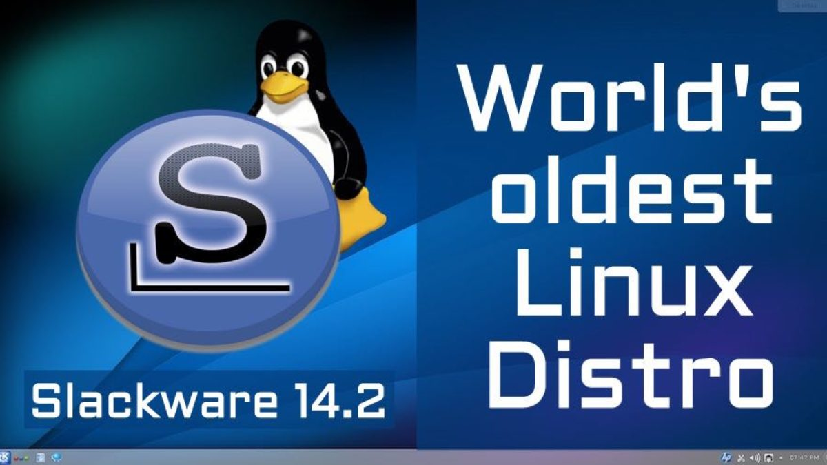
1993
Memorable Linux Events
Notes:
1993: Slackware Linux released
Slackware Linux version 1.0 was released on 17th July 1993. If you think why it is so important to mention it, let me tell you that Slackware Linux is the oldest Linux which is still in development.

Slide 22
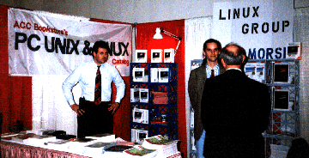
1995
Memorable Linux Events
Notes:
1995: First Linux Expo
First Linux specific tradeshow and conference series were launched by people at North Carolina State University. This became one of the most attended annual Linux show for next several years.

Slide 23

1996
Memorable Linux Events
Notes:
1996: Tux gets to be the symbol of Linux
Though Linus Torvalds was once bitten by a penguin, he still recommended a penguin as the mascot of Linux. Tux was created by Larry Ewing in 1996. Tux has been unchanged for last 25 years.

Slide 24

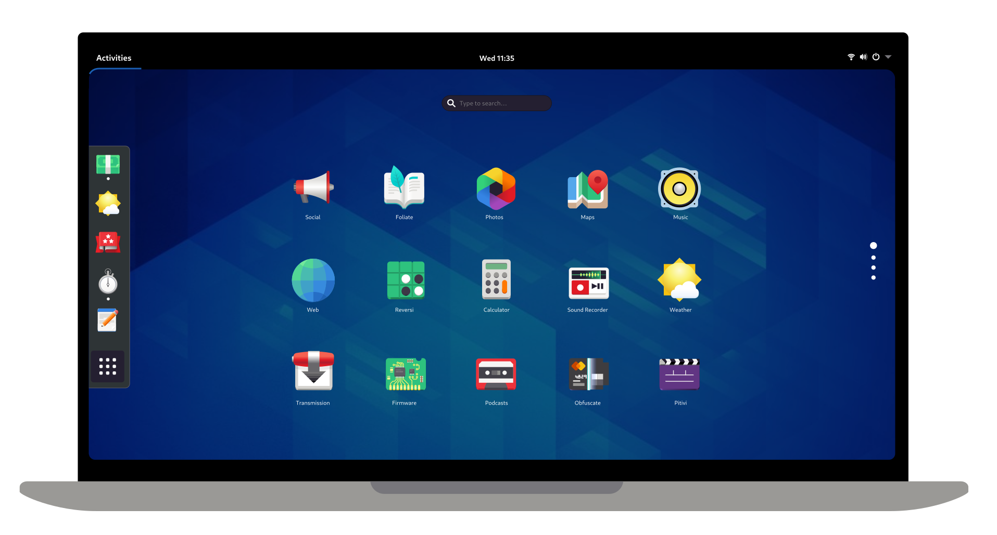
1997
Memorable Linux Events
Notes:
1997: GNOME Project is born
GNOME is one of the most successful open source projects. It has been crucial to the spread of desktop Linux. It has given us a number of programs that we use today on desktop Linux.

Slide 25
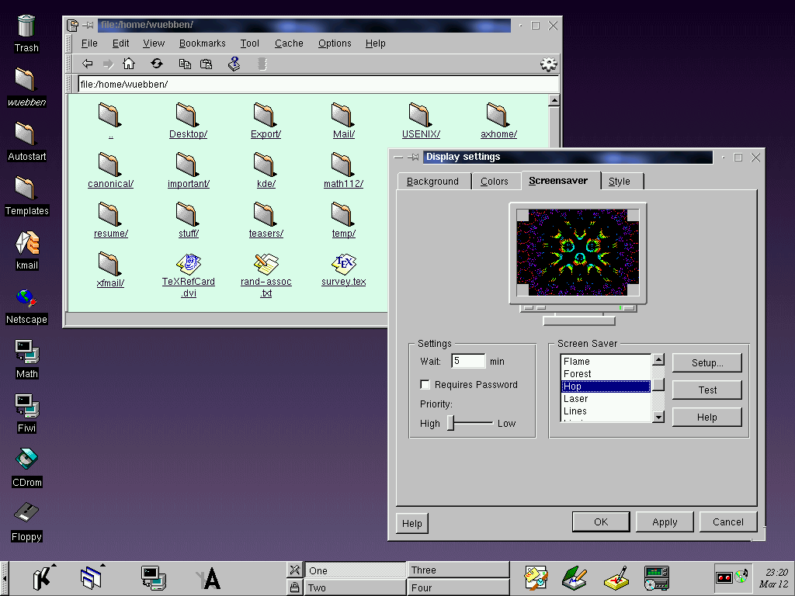
1998
Memorable Linux Events
Notes:
1998: KDE 1.0 released
Another crucial part of desktop Linux, KDE project saw its first stable release in 1998. Like GNOME, KDE too has been a crucial part of desktop Linux.

Slide 26
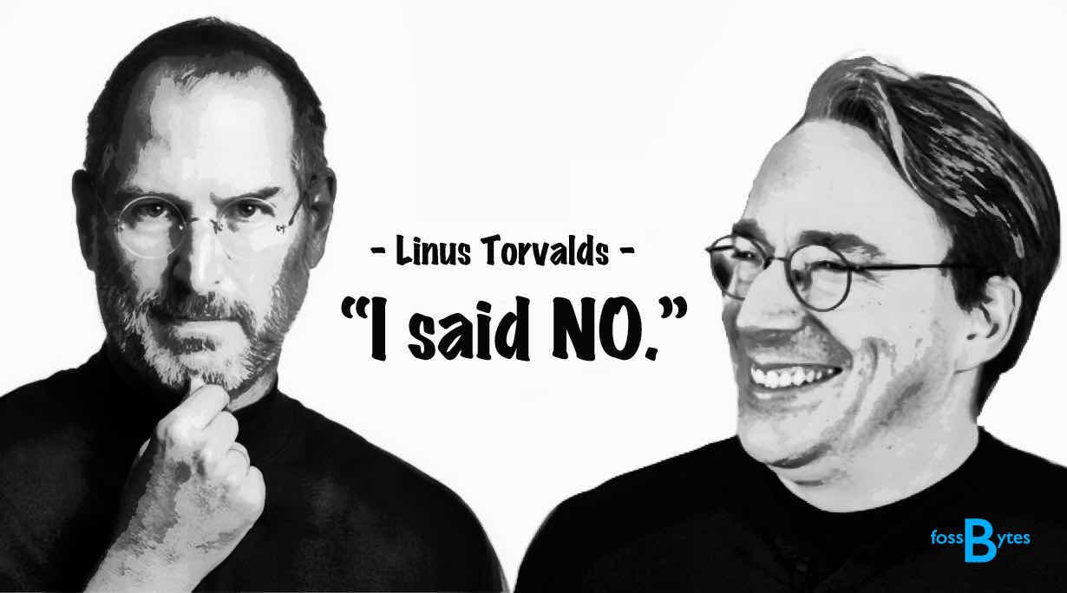
2000
Memorable Linux Events
Notes:
2000: Steve Jobs made an offer that Linus refused
Steve Jobs offered Linus Torvalds to come work for Mac OS to make “Unix for the biggest user base”. Not only this, Jobs even tried to persuade Linus to drop working on Linux.
Needless to say, Linus refused the offer and continued to work on Linux. And we cannot be more happy about it.

Slide 27

2002
Memorable Linux Events
Notes:
2002: Red Hat Enterprise Linux released
The first commercial Linux for Business IT was released in the year 2002. RHEL is one of the few Linux distributions that changed Linux forever.

Slide 28

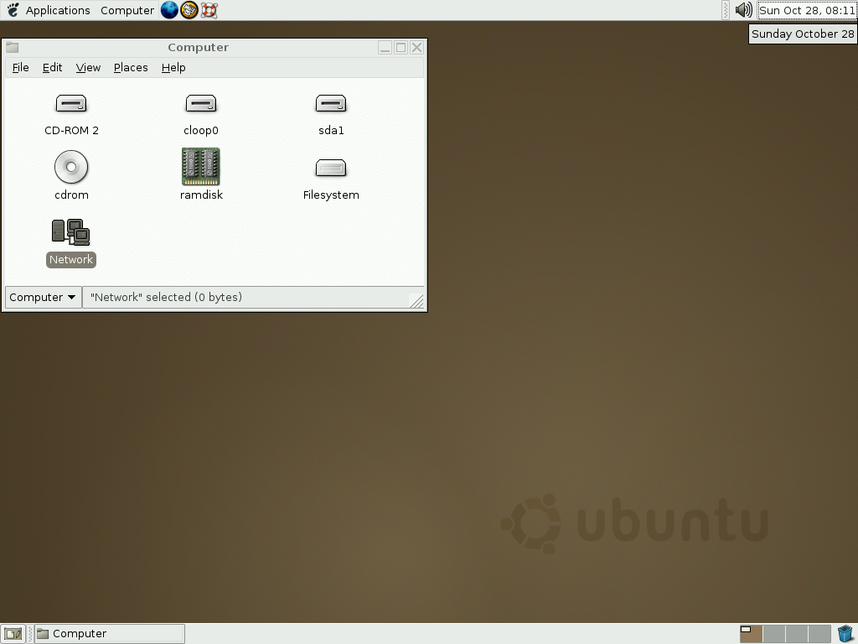
2004
Memorable Linux Events
Notes:
2004: Ubuntu 4.10 released
On 20th October 2004, Ubuntu 4.10 was released. This new Linux distribution marketed itself as Linux for human being.
I don’t need to tell you that Ubuntu was a revolutionary distribution that actually made it easier for normal users to install and use Linux. With Ubuntu, Linux reached to the non-geek domain.

Slide 29

2005
Memorable Linux Events
Notes:
2005: Linus Torvalds created Git
For years, proprietary software BitKeeper was used for version control in Linux Kernel development. Free Software founder Richard Stallman heavily criticized the use of a proprietary software for the development of an open source software.
However, Linus Torvalds did not find any better option for maintaining the ever growing code. But in 2005, BitKeeper decided to not provide the free version to the community anymore.
This forced Linus Torvalds to work on his own version control system and thus Git was born.

Slide 30
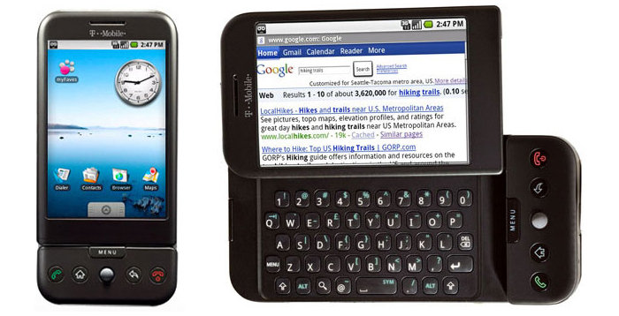
2008
Memorable Linux Events
Notes:
2008: Android version 1.0 released
With the release of Android, a mobile operating system based on Linux Kernel, Linux took the first step in the world of mobile OS.
While desktop Linux might not have been that big a success, with Android, Linux is dominating the world of mobile OS.

Slide 31
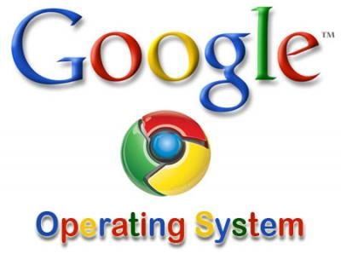

2009
Memorable Linux Events
Notes:
2009: Google announced Chrome OS
Google announces its own (sort of) desktop operating system Chrome OS, based on Linux kernel. Later on, Google also started releasing Chromebooks, dedicated devices to run Chrome OS. Chromebooks have grown in popularity in recent years.

Slide 32
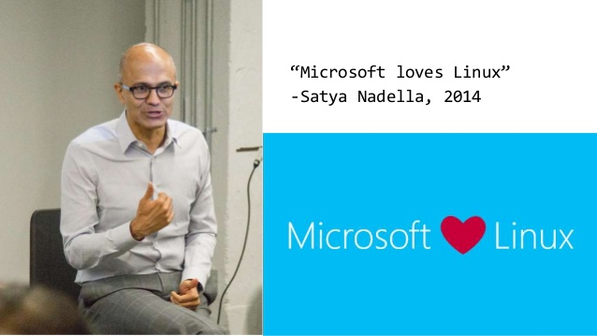
2014
Memorable Linux Events
Notes:
2014: Microsoft loves Linux
Microsoft’s new CEO Satya Nadella shocked the tech world with his “Microsoft loves Linux” remark. As we see later that this was just the beginning of Microsoft’s grand design to rule cloud world.
However, this actually brought a shift in Microsoft policies and for the first time Microsoft started open sourcing its products and bringing it to Linux.

Slide 33
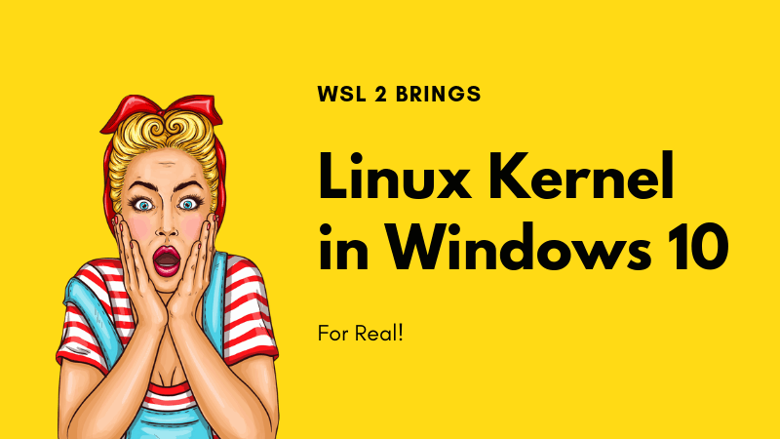
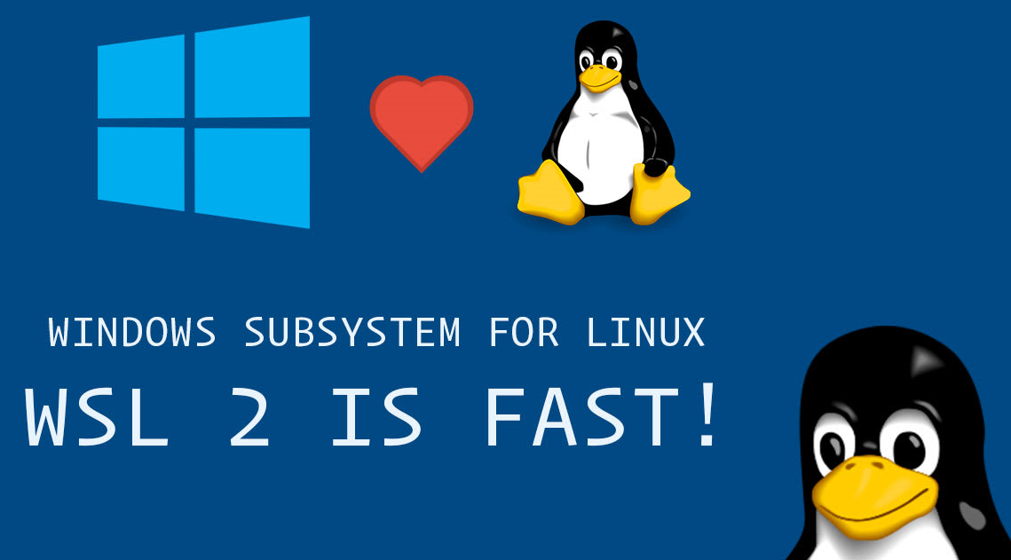
2019
Memorable Linux Events
Notes:
o

Slide 34
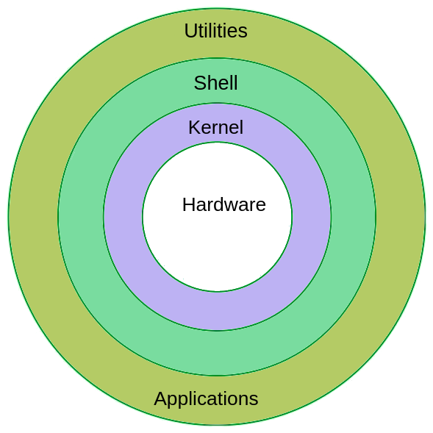
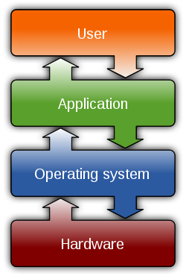
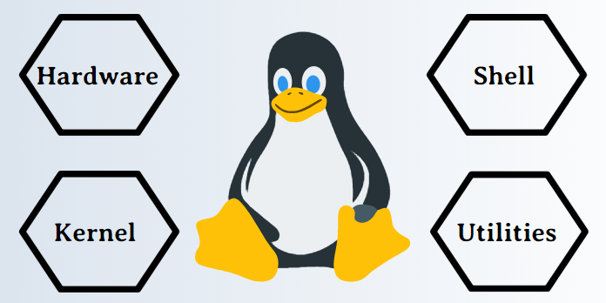
Components of Linux
USER
Notes:
So, let’s change our view from historical evolution to more technical details.
For understanding the components, First you need to understand what a computer operating system or OS is. As I’ve stated earlier, an OS is the computer code which manages the hardware in a physical computer. It exists as a layer between your software and your hardware. Most people writing software do not want to know how to address a CPU in assembler, or how to communicate with a graphics card. An OS such as Linux or Windows acts as a middleman.
Every OS has component parts, and the Linux also has the following components:
Bootloader. Your computer needs to go through a startup sequence called booting. This boot process needs guidance, and your OS is the software in control throughout the boot process. When you start your computer the bootloader for your operating system kickstarts the process.
OS Kernel. You can call the kernel the part of the operating system which is the “closest” to your computing hardware as it is the part which controls the CPU, access to memory and any peripheral devices. It is the “lowest” level at which your operating system works.
Background services. Called “daemons” in Linux, these small applications act as servants in the background, ensuring that key functions such as scheduling, printing and multimedia function correctly. They load after you have booted up, or when you have logged into your computer.
OS Shell. You need to be able to tell our operating system what to do, and this is the goal of the shell. Also known as the command line, it is a facility which lets you instruct your OS using text. However few people nowadays are familiar with command line code, and it once used to put people off using Linux. This changed because a modern distribution of Linux will use a desktop shell just like Windows.
Graphics server. This provides a graphical sub-system that renders images and shapes on your computer monitor. Linux uses a graphical server called “X” or “X-server”.
Desktop environment. You can’t interact with the graphical server directly. Instead you need software that can drive the server. This is called a desktop environment in Linux and there are plenty of options including KDE, Unity and Cinnamon. A desktop environment is usually bundled with a number of applications including file and web browsers plus a couple of games.
Applications. Obviously, the desktop environment which is bundled with your Linux OS or which you choose to install cannot cater for every application need, there are too many. Individual applications, however, can and there are thousands for Linux just like Windows and Apple’s OS X has thousands of applications. Most Linux distros have app stores which help you find and install apps, for example Ubuntu Software which comes with Ubuntu.
It’s worth noting that Ubuntu’s application repository, the Ubuntu software centre, is a great place to look around for Linux applications, both free to use and paid to use.

Slide 35
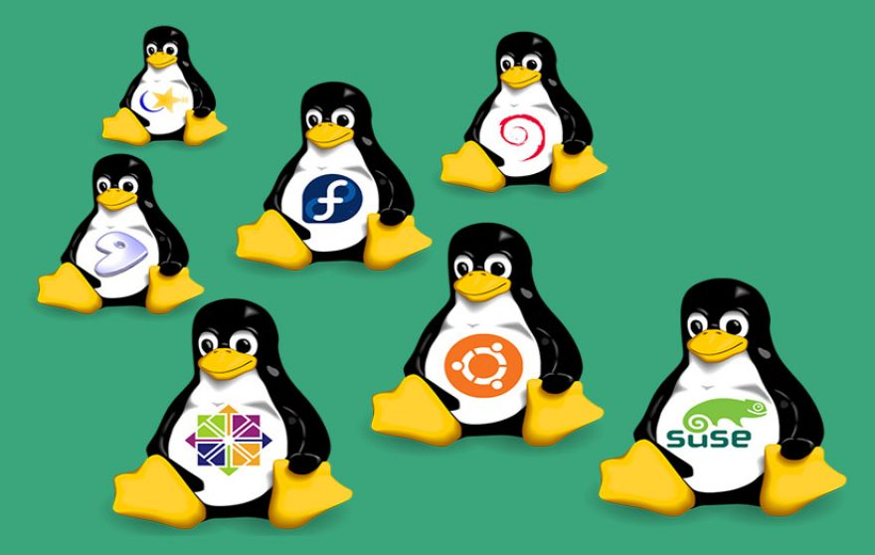
Popular Linux Distributions
Debian
Ubuntu
Mint
Manjaro
openSUSE
RedHat
Fedora
Notes:
And what the heck is this? Distro? A Linux distribution (often abbreviated as distro) is an operating system made from a software collection that is based upon the Linux kernel and, often, a package management system. Linux users usually obtain their operating system by downloading one of the Linux distributions, which are available for a wide variety of systems ranging from embedded devices (for example, OpenWrt) and personal computers (for example, Linux Mint) to powerful supercomputers (for example, Rocks Cluster Distribution).
A typical Linux distribution comprises a Linux kernel, GNU tools and libraries, additional software, documentation, a window system (the most common being the X Window System), a window manager, and a desktop environment.
Most of the included software is free and open-source software made available both as compiled binaries and in source code form, allowing modifications to the original software. Usually, Linux distributions optionally include some proprietary software that may not be available in source code form, such as binary blobs required for some device drivers.^{[1]}
A Linux distribution may also be described as a particular assortment of application and utility software (various GNU tools and libraries, for example), packaged together with the Linux kernel in such a way that its capabilities meet the needs of many users.^{[2]} The software is usually adapted to the distribution and then packaged into software packages by the distribution's maintainers. The software packages are available online in so-called repositories, which are storage locations usually distributed around the world.^{[3][4]} Beside glue components, such as the distribution installers (for example, Debian-Installer and Anaconda) or the package management systems, there are only very few packages that are originally written from the ground up by the maintainers of a Linux distribution.
https://en.wikipedia.org/wiki/Linux_distribution

Slide 36
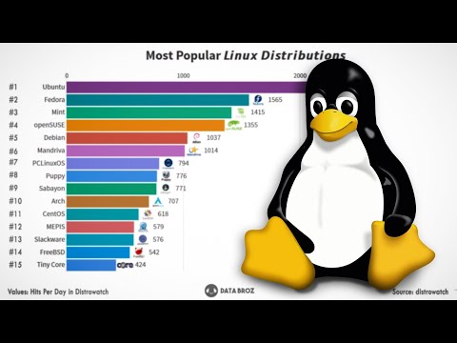
Notes:
Almost six hundred Linux distributions exist, with close to five hundred out of those in active development.^{[5]} Because of the huge availability of software, distributions have taken a wide variety of forms, including those suitable for use on desktops, servers, laptops, netbooks, mobile phones and tablets,^{[6][7]} as well as minimal environments typically for use in embedded systems.^{[8][9]} There are commercially-backed distributions, such as Fedora (Red Hat), openSUSE (SUSE) and Ubuntu (Canonical Ltd.), and entirely community-driven distributions, such as Debian, Slackware, Gentoo and Arch Linux. Most distributions come ready to use and pre-compiled for a specific instruction set, while some distributions (such as Gentoo) are distributed mostly in source code form and compiled locally during installation.
Here is a nice video which shows the Linux distro popularity in accordance with years.
https://www.youtube.com/watch?v=LmoAJR-0oas

Slide 37
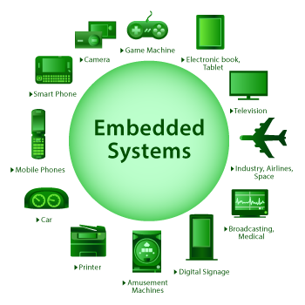


Linux Embedded Systems
Embedded System
An embedded system is a computer system that is dedicated to one or two specific functions.
Notes:
And what about Linux embedded systems?
Operating systems based on the Linux kernel are used in embedded systems such as consumer electronics (i.e. set-top boxes, smart TVs, personal video recorders), in-vehicle infotainment (IVI), networking equipment (such as routers, switches, wireless access points (WAPs) or wireless routers), machine control, industrial automation, navigation equipment, spacecraft flight software, and medical instruments in general.
Because of their versatility, operating systems based on the Linux kernel can be also found in mobile devices that are actually touchscreen-based embedded devices, such as smartphones and tablets, together with personal digital assistants (PDAs) and portable media players that also include a touchscreen. This is a challenge for most learners because their computer experience is mainly based on GUI (Graphical user interface) based interaction with the machine and high-level programming on the one hand and low-level programming of small microcontrollers on the other hand while the concept of command line interfaces is widely unknown.

Slide 38
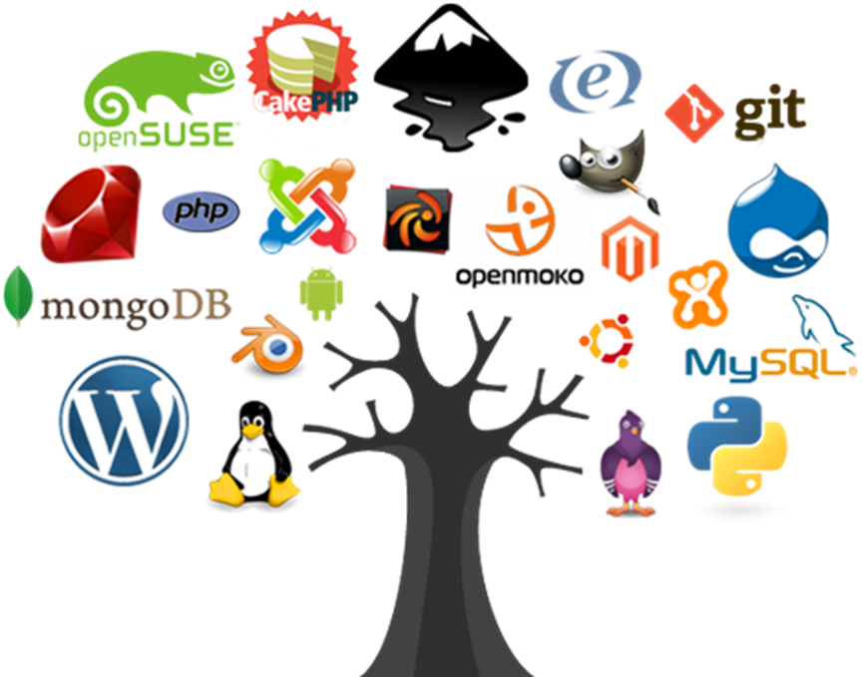
Major Open Source Applications
Notes:
Now let’s change our focus to open source and open source apps.
The term open source refers to, something people can modify and share because its design is publicly accessible.
The term originated in the context of software development to designate a specific approach to creating computer programs. Today, however, "open source" designates a broader set of values—what we call "the open source way." Open source projects, products, or initiatives embrace and celebrate principles of open exchange, collaborative participation, rapid prototyping, transparency, meritocracy, and community-oriented development.
https://opensource.com/resources/what-open-source

Slide 39

What is open-source
Open-source software is software with source code that anyone can inspect, modify, and enhance.
Notes:
So, what is open source software?
Open source software is software with source code that anyone can inspect, modify, and enhance.
"Source code" is the part of software that most computer users don't ever see; it's the code computer programmers can manipulate to change how a piece of software—a "program" or "application"—works. Programmers who have access to a computer program's source code can improve that program by adding features to it or fixing parts that don't always work correctly.
And what's the difference between open source software and other types of software?
Some software has source code that only the person, team, or organization who created it—and maintains exclusive control over it—can modify. People call this kind of software "proprietary" or "closed source" software.
Only the original authors of proprietary software can legally copy, inspect, and alter that software. And in order to use proprietary software, computer users must agree (usually by signing a license displayed the first time they run this software) that they will not do anything with the software that the software's authors have not expressly permitted. Microsoft Office and Adobe Photoshop are examples of proprietary software.
Open source software is different. Its authors make its source code available to others who would like to view that code, copy it, learn from it, alter it, or share it. LibreOffice and the GNU Image Manipulation Program are examples of open source software.
As they do with proprietary software, users must accept the terms of a license when they use open source software—but the legal terms of open source licenses differ dramatically from those of proprietary licenses.
Open source licenses affect the way people can use, study, modify, and distribute software. In general, open source licenses grant computer users permission to use open source software for any purpose they wish. Some open source licenses—what some people call "copyleft" licenses—stipulate that anyone who releases a modified open source program must also release the source code for that program alongside it. Moreover, some open source licenses stipulate that anyone who alters and shares a program with others must also share that program's source code without charging a licensing fee for it.
By design, open source software licenses promote collaboration and sharing because they permit other people to make modifications to source code and incorporate those changes into their own projects. They encourage computer programmers to access, view, and modify open source software whenever they like, as long as they let others do the same when they share their work.
Is open source software only important to computer programmers?
No. Open source technology and open source thinking both benefit programmers and non-programmers.
Because early inventors built much of the Internet itself on open source technologies—like the Linux operating system and the Apache Web server application—anyone using the Internet today benefits from open source software.
Every time computer users view web pages, check email, chat with friends, stream music online, or play multiplayer video games, their computers, mobile phones, or gaming consoles connect to a global network of computers using open source software to route and transmit their data to the "local" devices they have in front of them. The computers that do all this important work are typically located in faraway places that users don't actually see or can't physically access—which is why some people call these computers "remote computers."
More and more, people rely on remote computers when performing tasks they might otherwise perform on their local devices. For example, they may use online word processing, email management, and image editing software that they don't install and run on their personal computers. Instead, they simply access these programs on remote computers by using a Web browser or mobile phone application. When they do this, they're engaged in "remote computing."
Some people call remote computing "cloud computing," because it involves activities (like storing files, sharing photos, or watching videos) that incorporate not only local devices but also a global network of remote computers that form an "atmosphere" around them.
Cloud computing is an increasingly important aspect of everyday life with Internet-connected devices. Some cloud computing applications, like Google Apps, are proprietary. Others, like ownCloud and Nextcloud, are open source.
Cloud computing applications run "on top" of additional software that helps them operate smoothly and efficiently, so people will often say that software running "underneath" cloud computing applications acts as a "platform" for those applications. Cloud computing platforms can be open source or closed source. OpenStack is an example of an open source cloud computing platform.

Slide 40
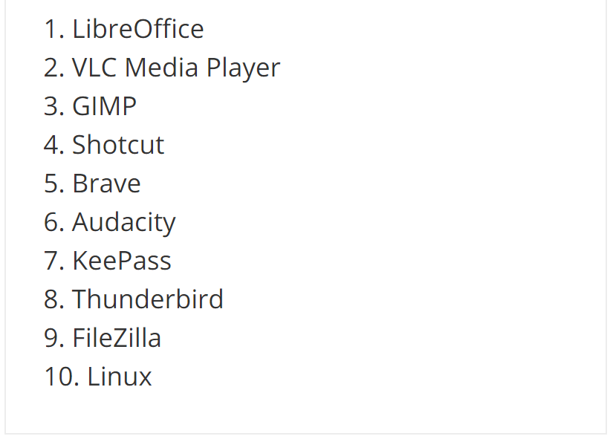




Desktop Applications
Cited from: https://www.techradar.com/best/best-open-source-software
Notes:
You can see some open source desktop applications on the screen. As you see, there are many different software alternatives.
So, why do people prefer using open source software? Any idea?
People prefer open source software to proprietary software for a number of reasons, including:
Control. Many people prefer open source software because they have more control over that kind of software. They can examine the code to make sure it's not doing anything they don't want it to do, and they can change parts of it they don't like. Users who aren't programmers also benefit from open source software, because they can use this software for any purpose they wish—not merely the way someone else thinks they should.
Training. Other people like open source software because it helps them become better programmers. Because open source code is publicly accessible, students can easily study it as they learn to make better software. Students can also share their work with others, inviting comment and critique, as they develop their skills. When people discover mistakes in programs' source code, they can share those mistakes with others to help them avoid making those same mistakes themselves.
Security. Some people prefer open source software because they consider it more secure and stable than proprietary software. Because anyone can view and modify open source software, someone might spot and correct errors or omissions that a program's original authors might have missed. And because so many programmers can work on a piece of open source software without asking for permission from original authors, they can fix, update, and upgrade open source software more quickly than they can proprietary software.
Stability. Many users prefer open source software to proprietary software for important, long-term projects. Because programmers publicly distribute the source code for open source software, users relying on that software for critical tasks can be sure their tools won't disappear or fall into disrepair if their original creators stop working on them. Additionally, open source software tends to both incorporate and operate according to open standards.
Community. Open source software often inspires a community of users and developers to form around it. That's not unique to open source; many popular applications are the subject of meetups and user groups. But in the case of open source, the community isn't just a fanbase that buys in (emotionally or financially) to an elite user group; it's the people who produce, test, use, promote, and ultimately affect the software they love.

Slide 41





Server Applications
Apache Web Server
NGINX
MySQL
Samba
ownCloud
Notes:
And here are some open source server applications. And you can find many more.
So, Doesn't "open source" just mean something is free of charge?
No. This is a common misconception about what "open source" implies, and the concept's implications are not only economic.
Open source software programmers can charge money for the open source software they create or to which they contribute. But in some cases, because an open source license might require them to release their source code when they sell software to others, some programmers find that charging users money for software services and support (rather than for the software itself) is more lucrative. This way, their software remains free of charge, and they make money helping others install, use, and troubleshoot it.
While some open source software may be free of charge, skill in programming and troubleshooting open source software can be quite valuable. Many employers specifically seek to hire programmers with experience working on open source software.
https://www.techradar.com/best/best-open-source-software
https://opensource.com/business/16/8/top-5-open-source-web-servers
https://www.tecmint.com/best-open-source-web-servers/

Slide 42

Package Management Tools
Contemporary distributions of Linux-based operating systems install software in pre-compiled packages, which are archives that contain binaries of software, configuration files, and information about dependencies.
dpkg: Debian Package Manager
apt-get
rpm: Red Hat Package Manager
yum: yellowdog updater modified
Notes:
Before stepping into packet management let me try to explain “What a software repository is?”
A few years ago, before the proliferation of smartphones, the idea of a software repository was difficult for many users to grasp if they were not involved in the Linux ecosystem. To this day, most Windows users still seem to be hardwired to open a web browser to search for and install new software. However, those with smartphones have gotten used to the idea of a software "store." The way smartphone users obtain software and the way package managers work are not dissimilar. While there have been several attempts at making an attractive UI for software repositories, the vast majority of Linux users still use the command line to install packages. Software repositories are a centralized listing of all of the available software for any repository the system has been configured to use.
So, the Package managers which use these repos play an important role in Linux software management.
Linux adopted early the practice of maintaining a centralized location where users could find and install software. I will not overwhelm you with the details of software installation and more complicated software updating process since package managers have arrived.
So, what is a package?
Packages were invented to combat the complexity of installing software. Packages collect multiple data files together into a single archive file for easier portability and storage, or simply compress files to reduce storage space. The binaries included in a package are precompiled with according to the sane defaults the developer chosen. Packages also contain metadata, such as the software's name, a description of its purpose, a version number, and a list of dependencies necessary for the software to run properly.
Several flavors of Linux have created their own package formats. Some of the most commonly used package formats include:
.deb: This package format is used by Debian, Ubuntu, Linux Mint, and several other derivatives. It was the first package type to be created.
.rpm: This package format was originally called Red Hat Package Manager. It is used by Red Hat, Fedora, SUSE, and several other smaller distributions.
.tar.xz: While it is just a compressed tarball, this is the format that Arch Linux uses.
While packages themselves don't manage dependencies directly, they represented a huge step forward in Linux software management.
https://opensource.com/article/18/7/evolution-package-managers

Slide 43


Free Software Foundation (FSF)
Open Software Initiative (OSI)
Notes:
Now, we will look at the FSF and OSI shortly.

Slide 44
FSF and OSI
Free Software Foundation (FSF)
The Free Software Foundation (FSF) is a nonprofit organization with a worldwide mission to promote computer user freedom.
The FSF is working to secure freedom for computer users by promoting the development and use of free software and documentation.
https://www.fsf.org/
Notes:
The Free Software Foundation (FSF) is a nonprofit organization with a worldwide mission to promote computer user freedom. founded in 1985 to protect and promote free software.
The FSF is working to secure freedom for computer users by promoting the development and use of free software and documentation.
You can find reach set of documentation on the organization’s web site fsf.org.
https://www.fsf.org/
What is the Free Software Movement?
The free software movement campaigns to win for the users of computing the freedom that comes from free software. Free software puts its users in control of their own computing. Nonfree software puts its users under the power of the software's developer.
Free software means the users have the freedom to run, copy, distribute, study, change and improve the software.

Slide 45
FSF and OSI
Open Source Initiative (OSI)
The Open Source Initiative (OSI) is a non-profit organization dedicated to the promotion of open-source software.
OSI was founded in 1998 by Bruce Perens and Eric Raymond.
hhttps://opensource.org/
Notes:
On the other hand, The Open Source Initiative (OSI) is a non-profit organization dedicated to the promotion of open-source software.
OSI was founded in 1998 by Bruce Perens and Eric Raymond.
Similarly, you can find reach set of documentation on opensource.org.
https://opensource.org/
The Open Source Initiative (OSI) is a non-profit corporation with global scope formed to educate about and advocate for the benefits of open source and to build bridges among different constituencies in the open source community.

Slide 46
Open-Source Software and Licensing
Notes:
And guys what about the open source software licensing?
as you see these terms are very related each other and nested.

Slide 47

Open-source Licensing
Open source licenses are licenses that comply with the Open Source Definition — in brief, they allow the software to be freely used, modified, and shared. To be approved by the Open Source Initiative (also known as the OSI), a license must go through the Open Source Initiative's license review process.
Notes:
Open source licenses are licenses that comply with the Open Source Definition — in brief, they allow the software to be freely used, modified, and shared. To be approved by the Open Source Initiative (also known as the OSI), a license must go through the Open Source Initiative's license review process.
https://opensource.org/licenses

Slide 48

Open-source Licensing
Popular Licenses
The following OSI-approved licenses are popular, widely used, or have strong communities:
- Apache License 2.0
- BSD 3-Clause "New" or "Revised" license
- BSD 2-Clause "Simplified" or "FreeBSD" license
- GNU General Public License (GPL)
- GNU Library or "Lesser" General Public License (LGPL)
- MIT license
- Mozilla Public License 2.0
- Common Development and Distribution License
- Eclipse Public License version 2.0
Notes:
There are many different licenses being used in IT field. You needn’t know them all or the details. Here is a short list just for your general understanding and knowledge.
Generally, Open Source software is software that can be freely accessed, used, changed, and shared (in modified or unmodified form) by anyone. Open source software is made by many people, and distributed under licenses that comply with the Open Source Definition.
The internationally recognized Open Source Definition provides ten criteria that must be met for any software license, and the software distributed under that license, to be labeled "Open Source software." Only software licensed under an OSI-approved Open Source license should be labeled "Open Source" software.

Slide 49
Command Line Basics 1/2
Linux Essentials
Notes:
Good evening ladies and gentelman. I hope you are all doing good. Today, we will discuss Command Line Basics and generally shells. And more importantly, we will start doing hands on practices.
what linux is free, open source and OS
why is it so preferable, most known in IT area
what is its history, important turning points in the history like kernel, distros, mobile OS, Git etc
what is its components etc like after boatloader kernel, CLI,Xserver,GUI and applications
A kernel is the foundational layer of an operating system (OS). It functions at a basic level, communicating with hardware and managing resources, such as RAM and the CPU. Since a kernel handles many fundamental processes, it must be loaded at the beginning of the boot sequence when a computer starts up
Operating system is system program that runs on the computer to provide an interface to the computer user so that they can easily operate on the computer. Kernel is also a system program that controls all programs running on the computer. Kernel is basically a bridge between software and hardware of the system.
brain of the OS

Slide 50
Table of Contents
What is SHELL?
Basic SHELL Commands
Case Sensitivity
Simple Globbing
Notes:
Here are the topics we will cover during this session. The most important title here is the shell. Though we will not go deeper about theoretic foundations of the shell, we will start to use it in this session.

Slide 51

What is SHELL?
1
Notes:
So, what is shell? Any idea?

Slide 52
Components of Linux
USER
USER
Notes:
Kernel: It is the core part of the Linux system. It interacts with the hardware. It manages various components like the CPU, peripheral devices, and memory.
Shell: The Shell is an interface between the user and the Kernel. It takes user commands through the Terminal and processes the particular request.
Commands and Utilities: The Linux operating system comes with a Terminal that users can use to pass commands to the Shell. One simple command is the ‘ls’ which shows the contents of a folder
For understanding the components, First you need to understand what a computer operating system or OS is. As I’ve stated earlier, an OS is the computer code which manages the hardware in a physical computer. It exists as a layer between your software and your hardware. Most people writing software do not want to know how to address a CPU in assembler, or how to communicate with a graphics card. An OS such as Linux or Windows acts as a middleman.
Every OS has component parts, and the Linux also has the following components:
OS Kernel. You can call the kernel the part of the operating system which is the “closest” to your computing hardware as it is the part which controls the CPU, access to memory and any peripheral devices. It is the “lowest” level at which your operating system works.
OS Shell. You need to be able to tell our operating system what to do, and this is the goal of the shell. Also known as the command line, it is a facility which lets you instruct your OS using text. However few people nowadays are familiar with command line code, and it once used to put people off using Linux. This changed because a modern distribution of Linux will use a desktop shell just like Windows.
It’s worth noting that Ubuntu’s application repository, the Ubuntu software centre, is a great place to look around for Linux applications, both free to use and paid to use.

Slide 53
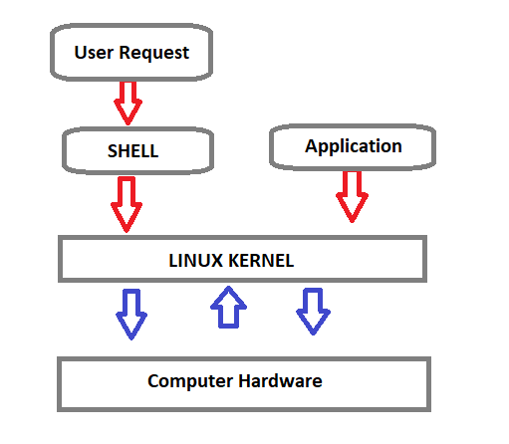
What is SHELL?
Shell is a program that receives the user's commands and gives them to the operating system to process and displays the output.
Bash (Bourne Again SHell) is an enhanced version of Steve Bourne's first Unix shell application, and serves as the shell program on most Linux systems.
Notes:
Shell is a program that receives the user's commands and gives them to the operating system for processing and displaying the output. Its distros come in the GUI, but essentially Linux has a CLI (command-line interface).
The shell is basically a program that takes keyboard commands and gives them to the operating system to conduct. A program called bash, serves as the shell program on most Linux systems (which stands for Bourne Again SHell, an enhanced version of Steve Bourne's first Unix shell application, sh).
https://www.journaldev.com/39194/different-types-of-shells-in-linux

Slide 54

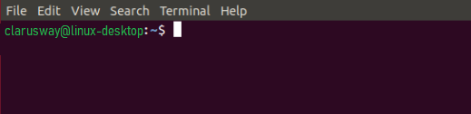
What is SHELL?
The standard Linux shell is both a command-line interpreter and a programming language.
The command prompt for Linux generally shows the current user, the current host, and the appropriate directory.
At the end of the prompt list, the $(dollar sign) signifies the current user being unprivileged, and the device is ready to receive feedback.
The input is sent for parsing and execution to the interpreter.
Notes:
The standard Linux shell is both a command-line interpreter and a programming language.
The command prompt at the beginning of the command line is a short text string. The command prompt for Linux generally shows the current user, the current host, and the appropriate directory.
The prompt of the command can be easily modified to display as desired more or less information. At the end of the prompt string, the $ (dollar sign) signifies that the current user is unprivileged, and the device is ready to receive feedback.
The input is sent for parsing and execution to the interpreter. The most common interpreter is BASH or the Bourne Again Shell, but there are others available, some of them are using different signs instead of the dollar sign.
some uses % instead of $ sign

Slide 55
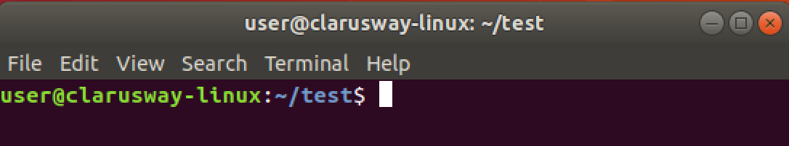
Command Prompt
User Name
Host Name
Current Directory
User Type
$ normal user
# Privileged user
Notes:
When we look deeply at the command prompt we see some details about our environment. For example, here, user refers to the current logged on user. And host name is generally the machine being used. Then, the current directory, where the user is working on and lastly user type, which is a $ sign means the current user is a normal user without extra privilages.

Slide 56
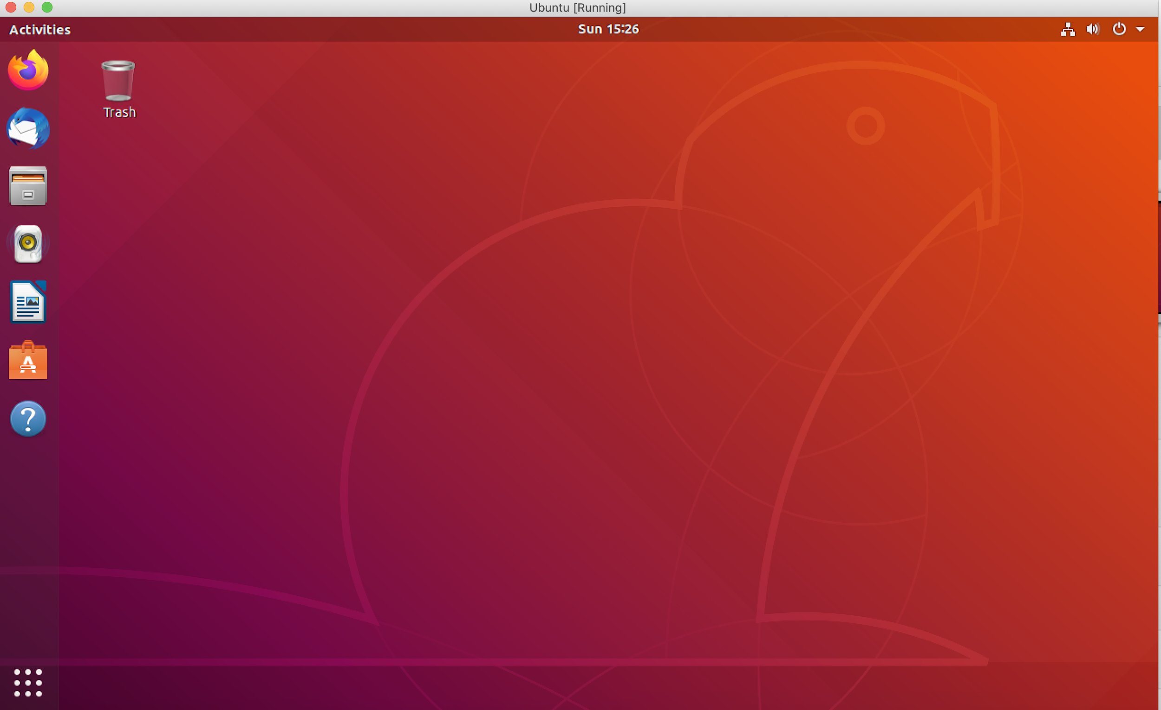
GUI

Slide 57
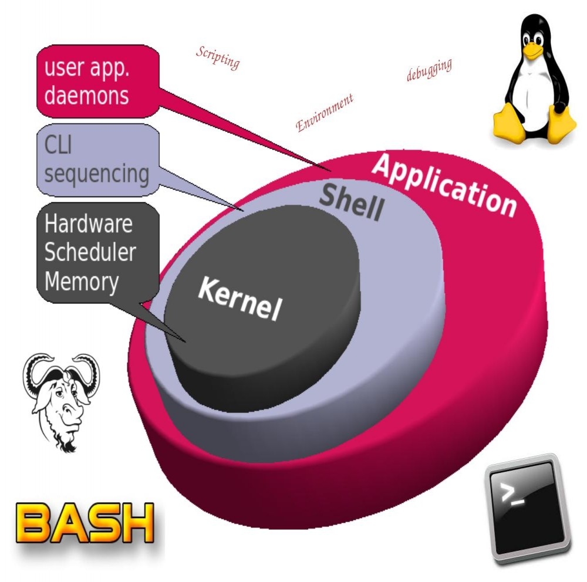
Basic SHELL
Commands
2
Notes:
At last, we can do some practice.
Now, let’s get our hands dirty guys. Before continuing, please start your shells, or open Linux simulators on your browsers.

Slide 58
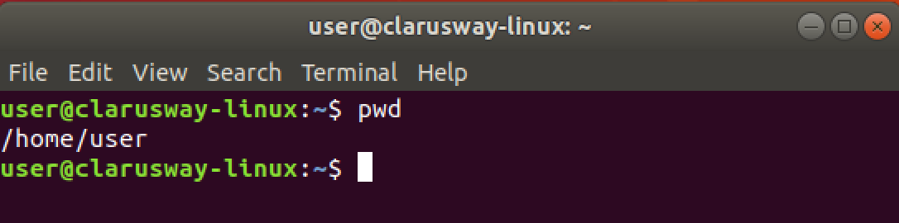
Basic Shell Commands
pwd show current path
(print working directory)
Notes:
Though you can see the current path on your command prompt, the most used command, in my opinion, is pwd.
It is my habit to look and confirm my working directory by using this command. Especially if you are the root user, it becomes more important to know where you are on the system. I do also suggest you use this command first ..
Let’s do it together please...

Slide 59
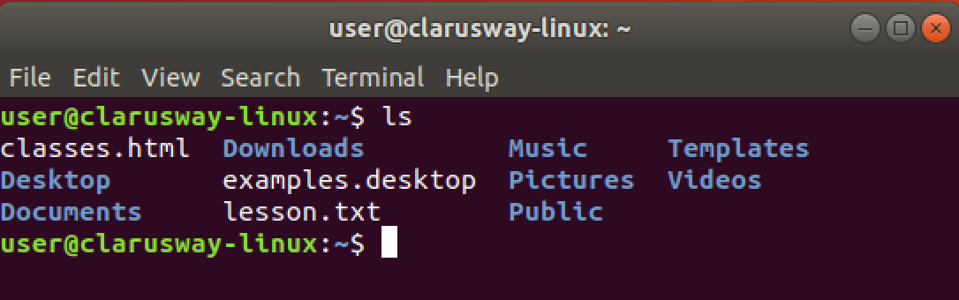
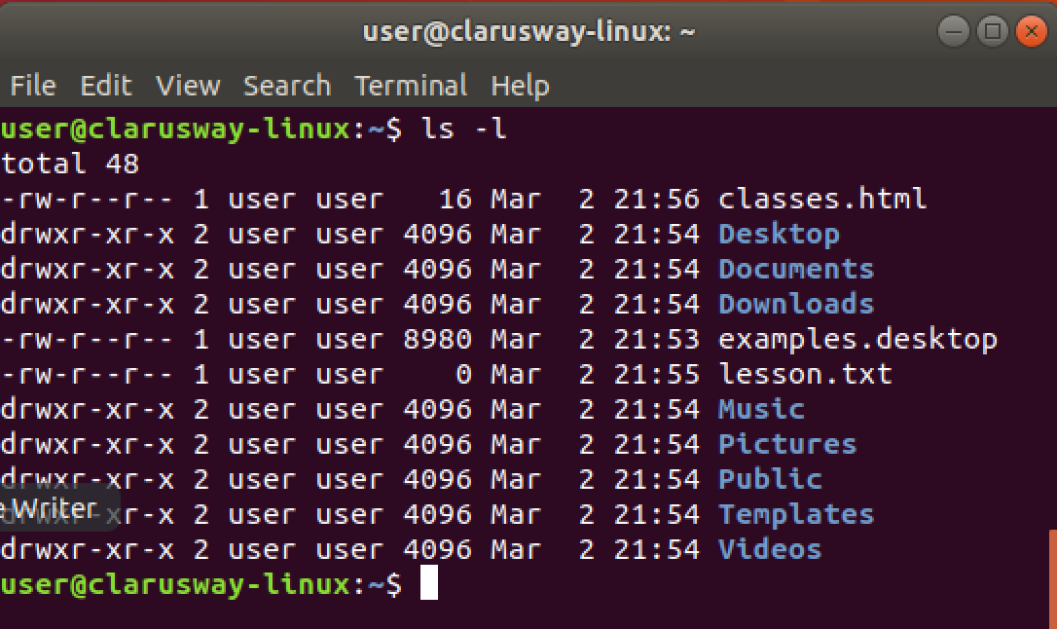
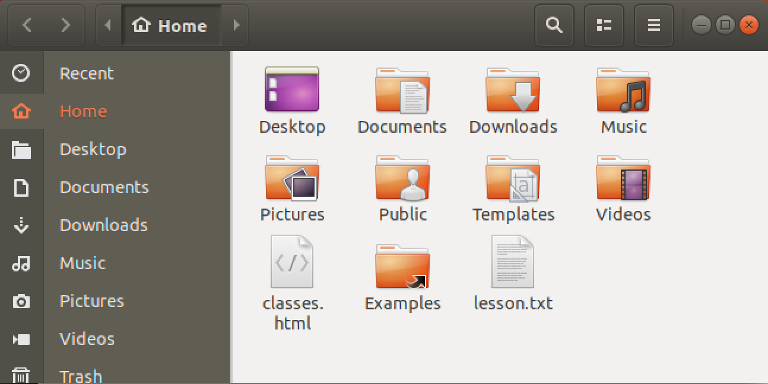
Basic Shell Commands
ls lists directory contents
ls -l lists directory contents with details
ls -a lists directory contents with
hidden folders and files
ls -al lists folder contents with hidden
files/folders and their details.
Notes:
ls, means list directory contents, is the most used command with pwd in Linux, I think.
It has many arguments, I mean options.
ls -l, ls -a, and ls -al are mostly used options for ls command. it should be space between options and command
Let’s check the contents of our current directories with different arguments.

Slide 60
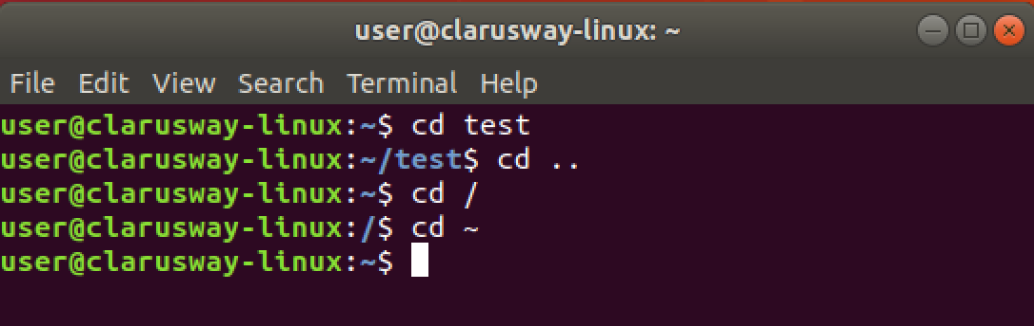
Basic Shell Commands
cd [dir] change (current) directory
cd .. change current directory
to one level up
cd / change current directory
to the root directory
cd ~ change current directory
to the home directory

Slide 61
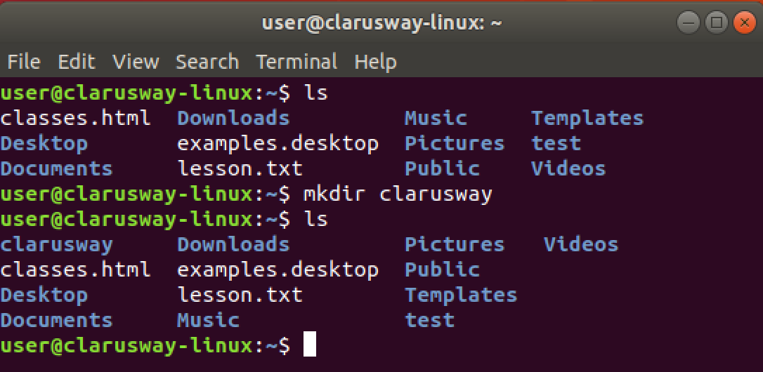
Basic Shell Commands
mkdir [dir] (make directory) create a new directory

Slide 62
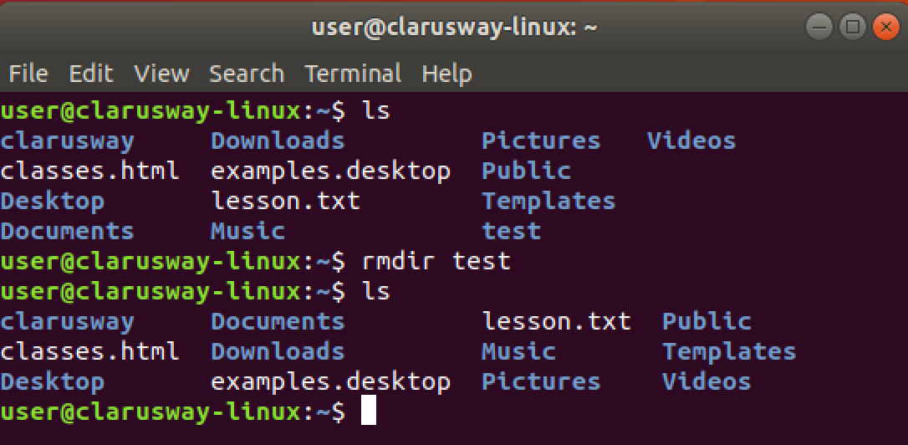
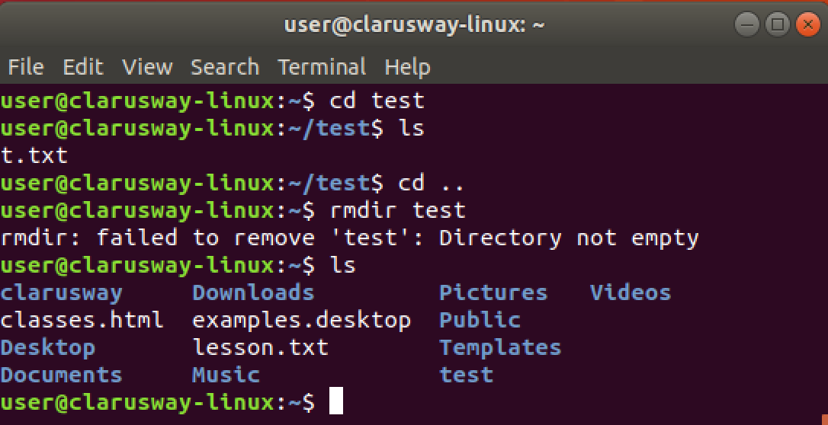
Basic Shell Commands
rmdir [dir] (remove directory) delete an empty directory
! It works if the folder content is empty, otherwise it gives a warning.

Slide 63
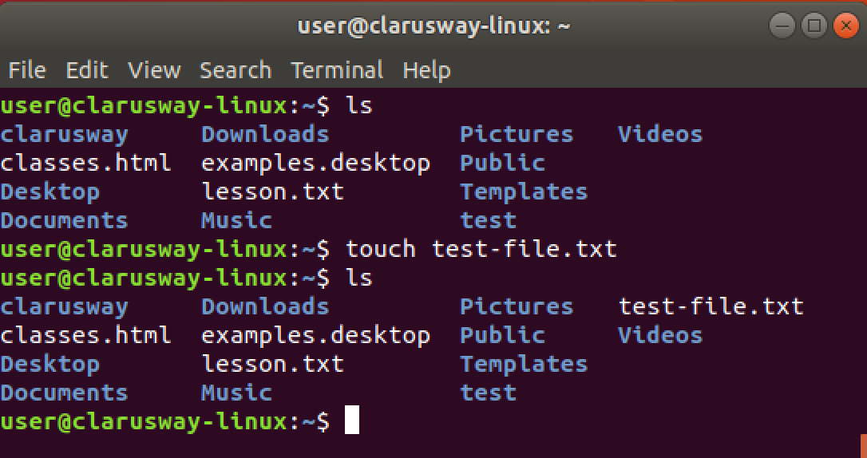
Basic Shell Commands
touch [filename] create a file
Notes:
to create an em

Slide 64
Basic Shell Commands
Quick Tips
mkdir dirname{1..10}
touch filename{a..z}
Notes:
Rmdir *
İçi dolu ise rm –r *
Rmdir ./FullStack/listeler
Rm –r ./fullStack/listeler
Mkdir ../denemeler üst dizinde oluştur
Mkdir –p Linux/denemeler/listeler hepsini oluşturur
Mkdir --help
Clear
Cat .bashhistory

Slide 65


Case Sensitivity
Most of the common Linux file systems are case sensitive; this is something to keep in mind when creating files or directories and moving through directories.
Lower-case and upper-case letters have different ASCII representation.
touch newfile
touch Newfile
Will create two different files.
Notes:
Let’s try together:
touch newfile
touch Newfile
ls -l
uppercase letter
lower case

Slide 66
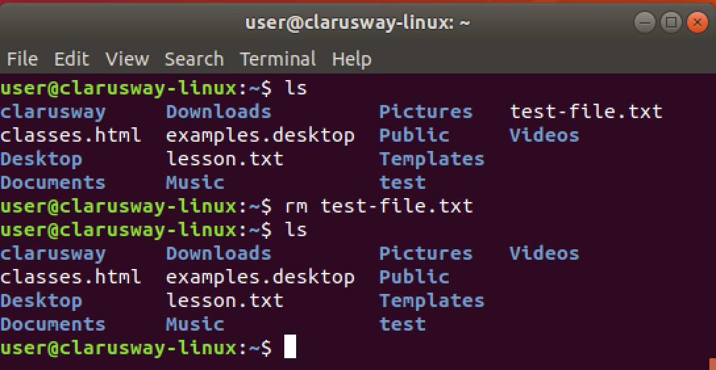
Basic Shell Commands
rm (remove) delete a file

Slide 67
Basic Shell Commands
rm -d directoryname = rmdir directoryname
rm -r directoryname
rm -f Remove all files in the working directory.
rm will not prompt you for any reason before deleting them
rm -rf

Slide 68
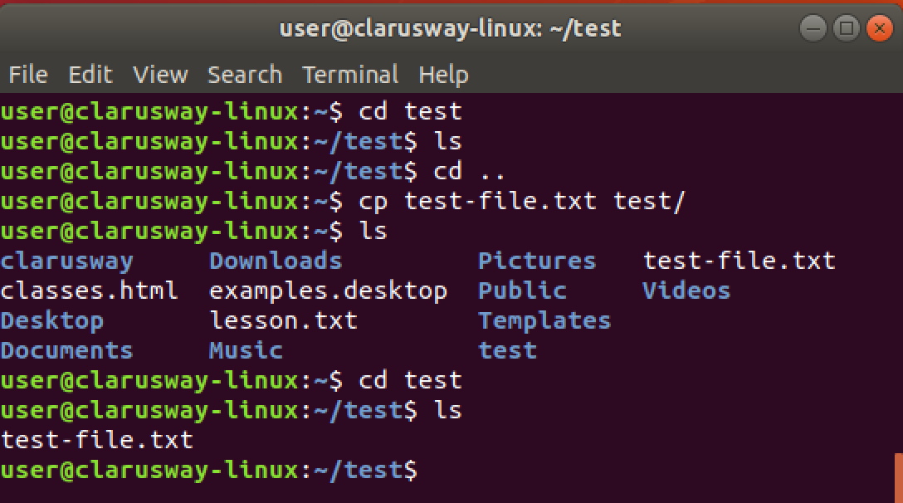
Basic Shell Commands
cp copy a file to another location

Slide 69
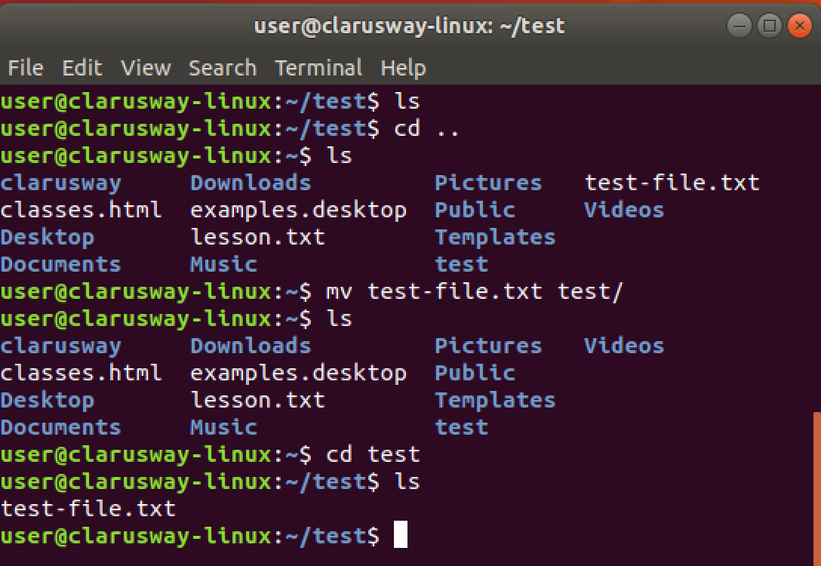
Basic Shell Commands
mv move a file to another location

Slide 70
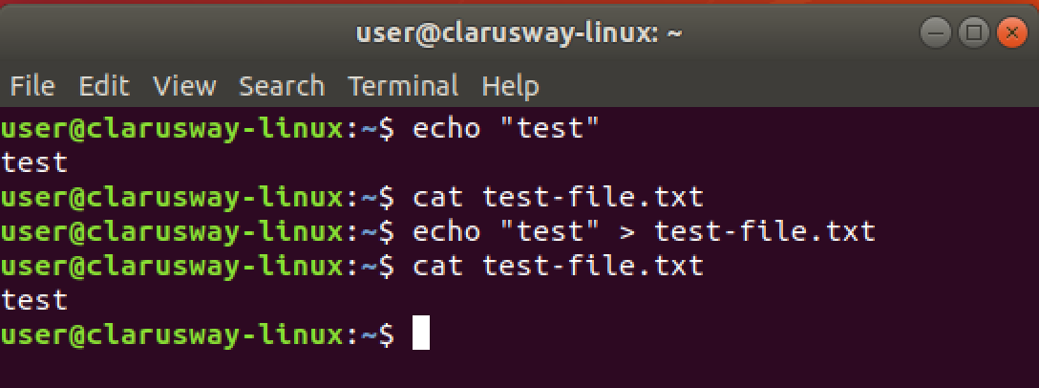
Basic Shell Commands
echo print message to screen
echo > [file] print message into a file
if the file doesn't exist it creates
echo >> [file] adds to existing content
Notes:
to create an em

Slide 71
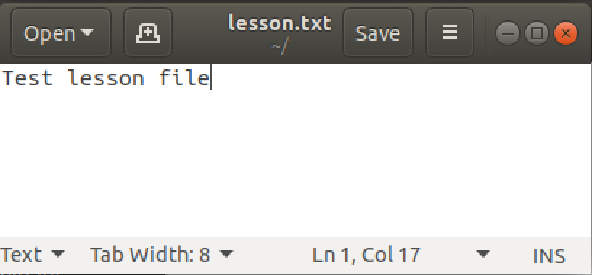
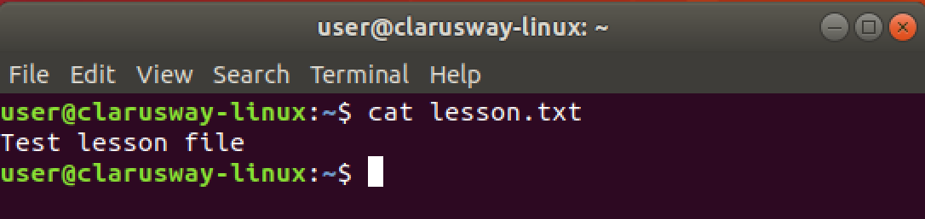
Basic Shell Commands
cat show file contents
cat > [filename] print message into a file
if the file doesn't exist
it creates
cat >> [filename] adds to existing content
Notes:
cat file1.txt file2.txt > file1andfile2.txt

Slide 72
Simple Globbing
Globbing is primarily used to match patterns in filenames or text by using a wildcard character to create a pattern.
Character | Name | Function
? | Question mark | Match any single character
* | Asterisk | Match any number of character(s)
[] | Brackets | Match character from a range
^ | Caret | Used to match starting character
$ | Dollar sign | Used to match ending character
{} | Curly brace | Used to match more than one pattern
| | Pipe | Used for applying more than one condition
Notes:
File globbing is a feature provided by the UNIX/Linux shell to represent multiple filenames by using special characters called wildcards with a single file name. A wildcard is essentially a symbol which may be used to substitute for one or more characters.

Slide 73
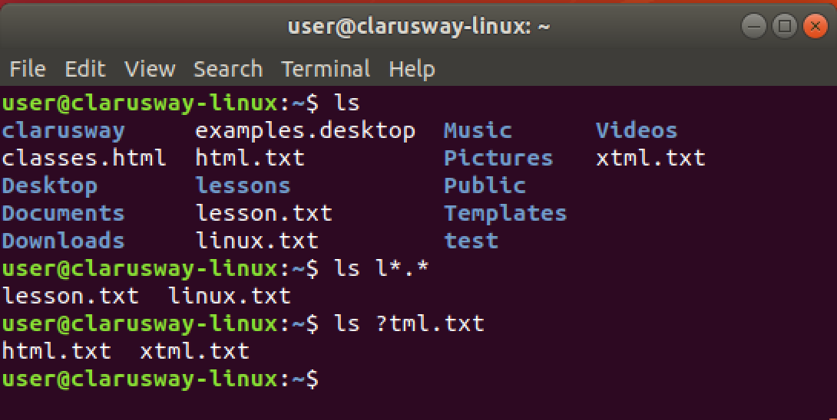
Multiple File/Directory Operations
? used for a single character
* used for multiple characters
Notes:
ls y[abcd]ng.txt
yang.txt
ybng.txt
ycng.txt
ydng.txt
ls post[0-9].tx
rm *.txt
ls ???t.txt 4 characters long and the last character is ‘t’

Slide 74
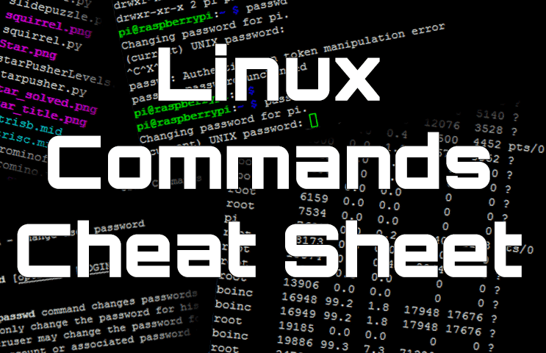
Basic SHELL Commands
Notes:
There are hundreds of commands on Linux systems and it is not possible for us to explain each of them one by one. You can search internet for cheat sheets and check different commands.
Linux commands may seem intimidating at first glance if you are not used to using the terminal. There are many commands for performing operations and processes on your Linux system.
No matter whether you are new to Linux or an experienced user, having a list of common commands close at hand is helpful.
for exp
The more you use Linux commands, the better you will get at remembering them. Do not stress about memorizing their syntax; use our cheat sheet.;
https://phoenixnap.com/kb/linux-commands-cheat-sheet

Slide 75

Basic SHELL Commands

Slide 76


Task
clarusway
materials
pre-class
lms.txt
post-class
try-it.txt
lessons
linux.txt
"I love linux”
html.txt
“I can create a website”
Notes:
ls
mkdir clarusway
cd clarusway
mkdir lessons
cd lessons
touch linux.txt
echo "I love linux" >linux.txt
touch html.txt
echo I "can create a website" > html.txt
cd ..
mkdir materials
cd materials
mkdir pre-class
cd pre-class
touch lms.txt
cd ..
mkdir post-class
cd post-class
touch try-it.txt
Short cut 3-4 = mkdir clarusway/lessons
touch lessons/linux.txt

Slide 77
THANKS !
Any questions?

